Slide 1
Data Ethics and Visualization Ethics
Part of the lecture series for the course 23CSE353 Data Visualization

Slide 2
Learning Objectives
Define data ethics and visualization ethics
Identify ethical issues across the data lifecycle
Recognize misleading visualization practices
Apply ethical frameworks to design decisions

Slide 3
Why Ethics Matter in Data Science
Ethical lapses in data science can cause societal harm and loss of trust.
Examples: Cambridge Analytica, biased predictive policing.
Ethics guide responsible use of data and visualization.

Slide 4
Foundations of Data Ethics
Core principles: Fairness, Accountability, Transparency, Privacy.
Frameworks: Belmont Report, Responsible Data Science Principles, EU AI Ethics Guidelines.

Slide 5
Ethical Issues Across the Data Lifecycle
Collection → Processing → Analysis → Visualization.
Common issues: bias, consent, manipulation, privacy breaches.

Slide 6
Bias and Fairness in Data
Bias arises from sampling, measurement, and algorithmic design.
Example: facial recognition systems misidentifying minorities.
Mitigation: diverse datasets, fairness audits, transparency.

Slide 7
Privacy and Consent
Ensure informed consent during data collection.
Use anonymization and secure data storage.
Respect user privacy and data minimization principles.

Slide 8
Accountability and Transparency
Communicate data sources and limitations.
Enable reproducibility and explainability.
Document ethical reasoning and design choices.

Slide 9
From Data Ethics to Visualization Ethics
Ethics extend beyond analysis—visualization shapes how audiences perceive truth.
Visualization ethics focus on truthfulness, clarity, proportionality, and inclusivity.

Slide 10
Misleading Visuals and Cognitive Biases
Examples: truncated axes, cherry-picked data, distorted scales.
Deceptive encodings exploit perceptual biases.

Slide 11
Ethical Guidelines for Visualization
Show the whole picture and maintain proportionality.
Use fair comparisons and avoid distortion.
Clearly label and cite data sources.

Slide 12
Case Study 1: Misleading Chart Correction
Original: Truncated y-axis exaggerating growth.
Correction: Full-scale axis shows moderate growth.
Lesson: Always preserve visual honesty.

Slide 13
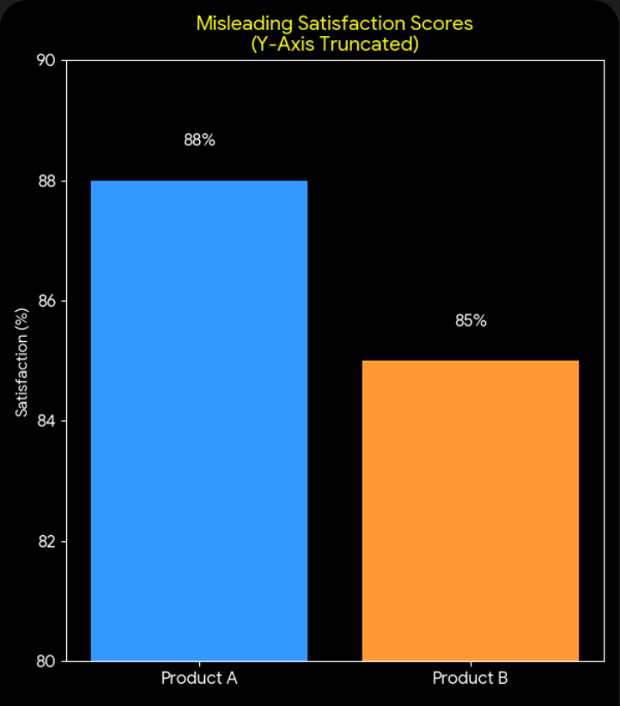
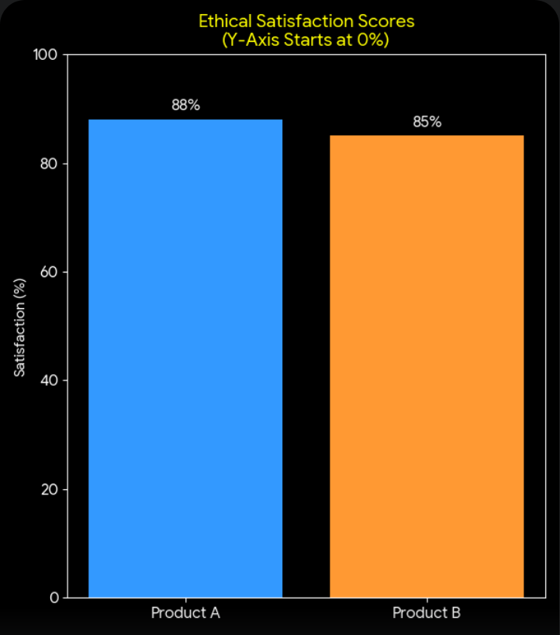
Example 1

Slide 14
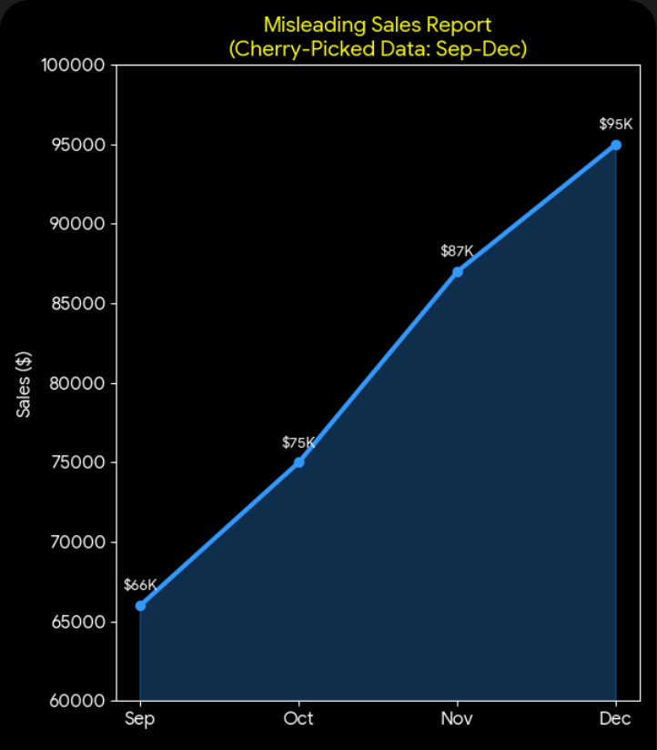
Example 2

Slide 15
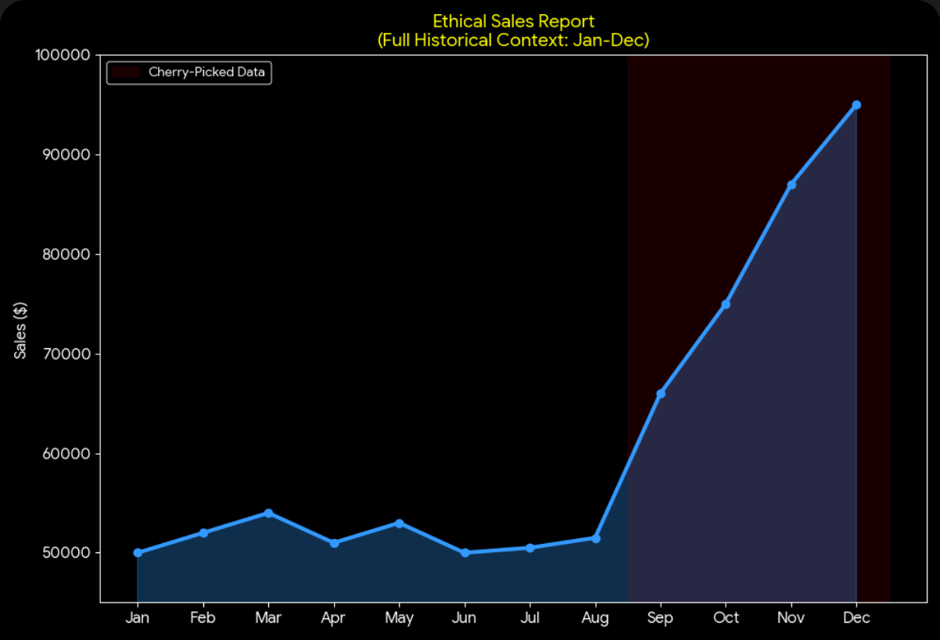
Example 2

Slide 16
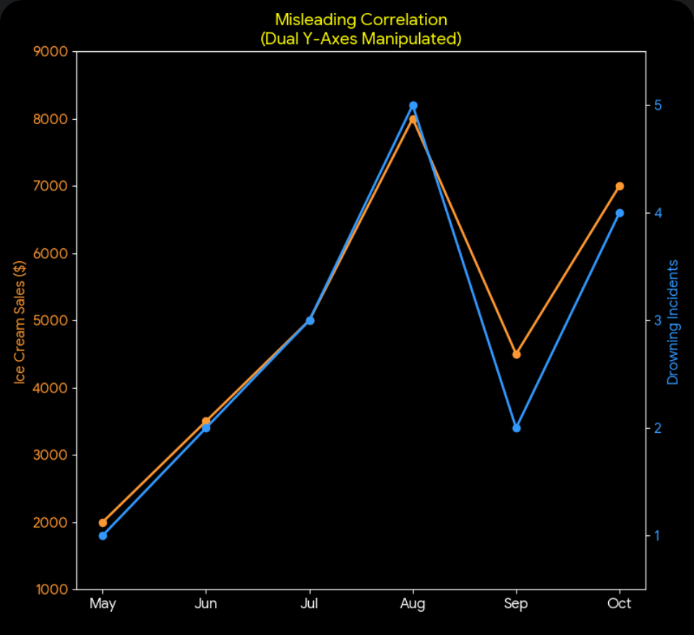
Example 3

Slide 17
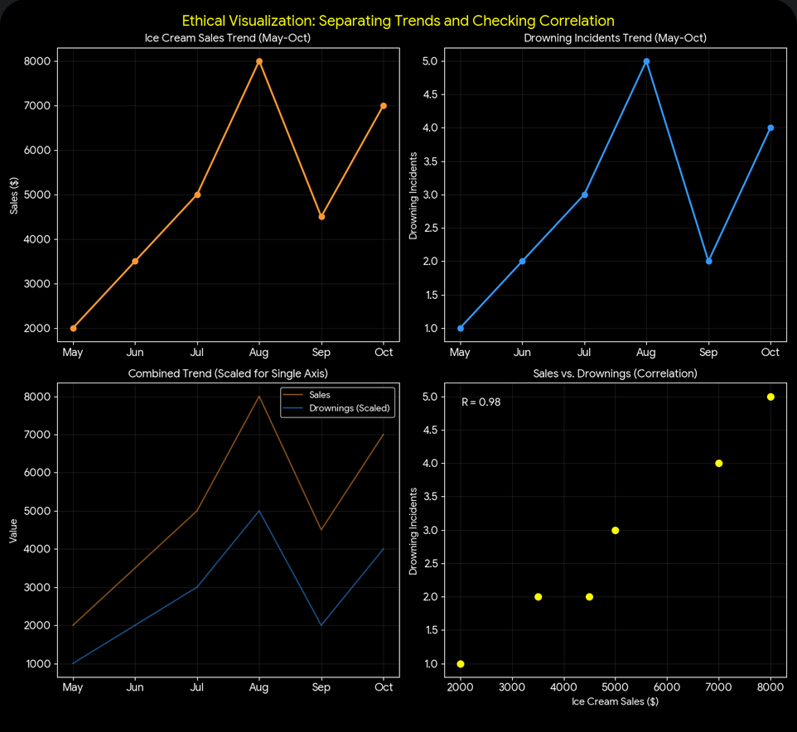
Example 3

